Slide 1






End-to-end training of Multimodal Model and ranking Model
arxiv24
Reported by Jiale Shen

Slide 2
motivation
1.Traditional recommender systems heavily rely on ID features, which often encounter challenges related to cold-start and generalization.Modeling pre-extracted content features can mitigate these issues,but is still a suboptimal solution due to the discrepancies between training tasks and model parameters.

Slide 3
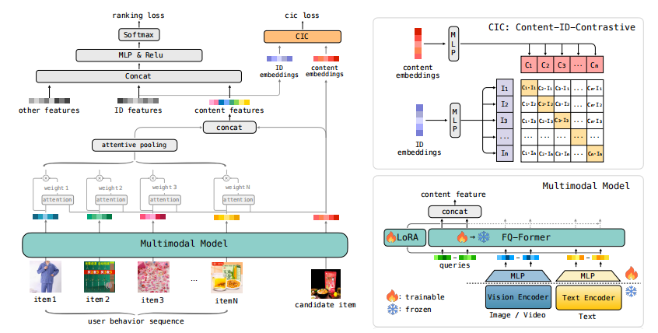
Overview

Slide 4
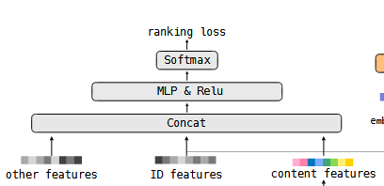

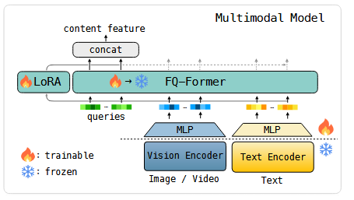


Approach

Slide 5
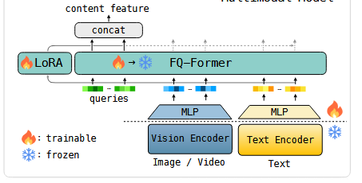

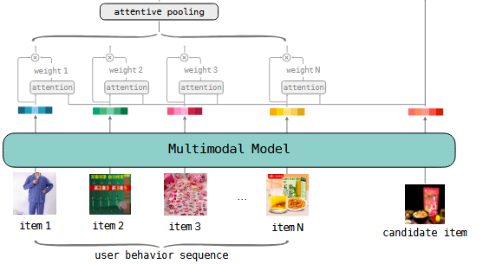
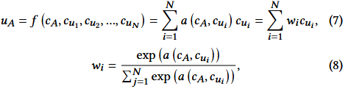
Approach

Slide 6
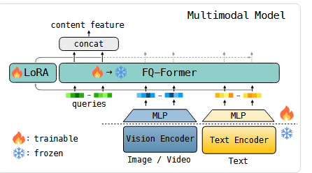
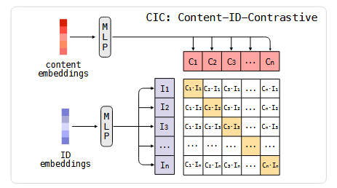

Approach

Slide 7
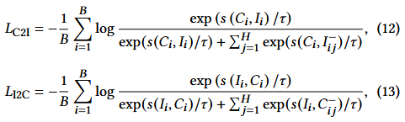
Approach

Slide 8
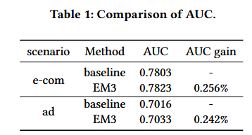
Experiment

Slide 9
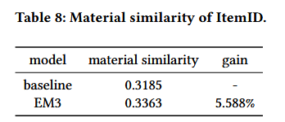
Experiment

Slide 10
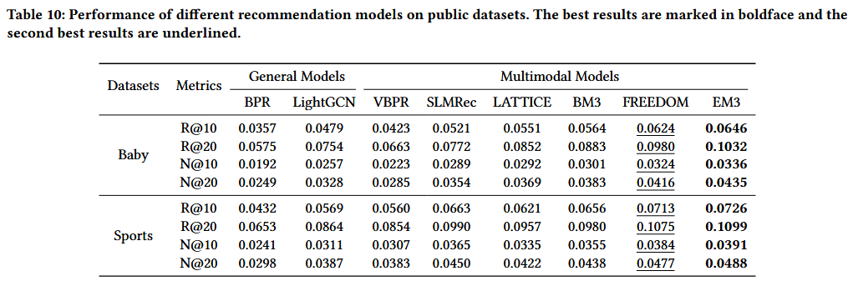
Experiment

Slide 11
Thank you!

